Slide 1
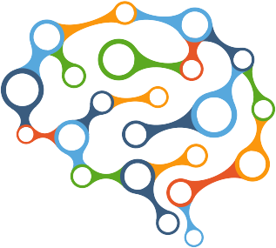
Fundamentals of AI
Intelligence and Computers

Slide 2

What is Intelligence?
Logical Deduction
Solving Problems
Making Decisions
Learning & Adapting

Slide 3




Kenneth Craik’s Model
An intelligent automaton…
Uses a small-scale model of world
Can perform actions
Knows effects of actions
Uses inference to make decisions

Slide 4
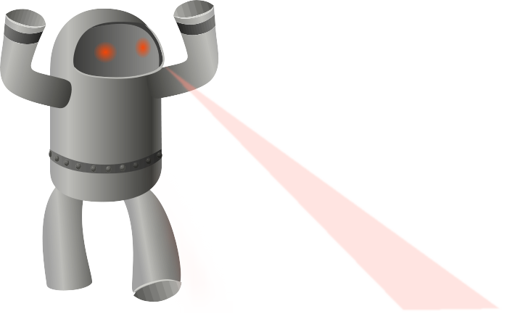
What is Artificial Intelligence?
Computers are pretty good at…
Computing (Arithmetic)
Remembering (Data Storage)
But extremely bad at…
Developing Solutions
Acting Independently
Changing
Through AI, we hope to give machines the ability to reason & appear more lifelike.

Slide 5


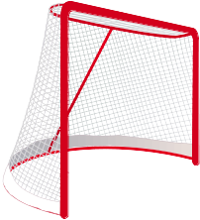
Agents, Agents, Everywhere!
We call an AI program or machine an agent.
Types of Agents Behavior
Reflex Reactionary
Goal-based Satisfying a goal
Utility-based Maximizing utility

Slide 6
Agent Architecture
The architecture of an agent will dictate how information comes in and is used.
Percepts
class Agent:
knowledge = KnowledgeStructure()
behavior = Behavior()
def enter():
…
def update():
…
def exit():
…
def onEvent(event):
…
Event Handler
Knowledge
Behavior
Actions

Slide 7

Knowledge Representation
Agents must remember…
What the world “looks like”
Processed information
Possible actions
Results of actions
Knowledge representation is critical to agent function!

Slide 8
Data Structures in AI
In AI, we use data structures for pretty much everything!
Tracking keys and/or values in a blackboard/toolbox (maps/sets)
Keeping track of search spaces (trees, maps, heaps, lists)
Remembering waypoints for pathfinding (graphs, lists)
Some industry folks have referred to AI “Advanced Data Structures”.

Slide 9
References
S. J. Russell & P. Norvig. 2010. Artificial intelligence: a modern approach. Pearson Education.
I. Millington & J. Funge. 2009. Artificial Intelligence for Games. CRC Press.

